Slide 2
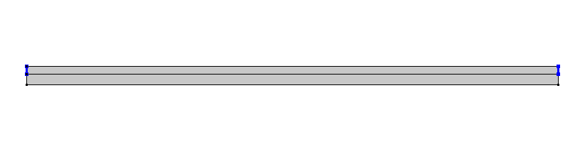
2D Basic setup in COMSOL
PMMA
Graphene
Fixed Constraint
Fixed Constraint
Air

